Slide 1
The CARES Act An Executive Summary of Mission Critical Features
Michael J. Passarella mpassarella@olshanlaw.com 212.451.2322 www.olshanlaw.com
Mark A. Limardo mlimardo@olshanlaw.com 212.451.2364 www.olshanlaw.com
April 23, 2020

Slide 2
Program Agenda
As the CARES Act covers a lot of ground, today’s presentation focuses on the following mission critical provisions:
Forgivable loans under the Paycheck Protection Program,
Non-forgivable loans under the EIDL Program,
Employer tax credits and other tax subsidies, and
Employee protections.

Slide 3
Q1: What is the Paycheck Protection Program (“PPP”)?
A1: The CARES Act establishes a forgivable loan program (referred to as the Paycheck Protection Program) under Section 7(a) of the Small Business Act (15 U.S.C. § 636). Under the PPP, an Eligible Borrower (as defined below) can borrow up to $10 million to pay covered payroll and other operational costs.
Note: The Small Business Administration (SBA) provides the bureaucratic infrastructure for the PPP and EIDL loan programs, which will be administered as small business loans through SBA lenders.

Slide 4
Q2: Who is an “Eligible Borrower” under the PPP?
A2: From 2/15/20 to 6/30/20 (the “Covered Period”), any employer (including any Section 501(c)(3) or other non-profit organization) with 500 or fewer W-2 employees (full or part-time) can borrow under the PPP. In addition, an employer with more than 500 employees can borrow under the PPP if the employer can otherwise qualify under the general SBA guidelines as a small business.
Note: As written, the CARES Act does NOT (a) specify when and how to apply the 500 - employee test during the Covered Period or (b) prevent an employer from shrinking into compliance through lay-offs or the reclassification of employees as independent contractors.

Slide 5
Q2(a): How does the 500 - employee test apply to the hospitality and food service industries?
A2(a): Under an alternate version of the 500 - employee test, an employer operating an NAICS Code 72 business with more than 500 employees (e.g., a hotel chain) can still meet the 500 - employee test if the employer has no more than 500 employees at any single physical location.

Slide 6
Q2(b): Do affiliation rules apply for purposes of the 500 - employee test?
A2(b): Yes. SBA affiliation rules apply in determining whether a potential Eligible Borrower meets the 500 - employee test, except that the CARES Act waives the affiliation rules for any employer: (a) operating NAICS Code 72 (hospitality/food services), (b) operating as a franchisee with assigned SBA franchise identifier code, or (c) receiving SBIC financial assistance.
Note: In general, SBA affiliation (brother/sister and parent/sub) triggers at 50 percent ownership, with lower percentages in “control” situations.

Slide 7
Q3: What if a business started after 2/15/20 or if a business has no employees?
A3: The business is not eligible to borrow under the PPP.

Slide 8
Q4: How much can an Eligible Borrower borrow under a PPP loan?
A4: An Eligible Borrower can borrow an amount equal to 2.5 times the Eligible Borrower’s Qualified Payroll Costs (as discussed in Q&A-5), up to a maximum of $10 million.

Slide 9
Q5: What are “Qualified Payroll Costs”?
A5: “Qualified Payroll Costs” are the total average monthly Payroll Costs paid by an Eligible Borrower during the one-year period ending on the PPP loan origination date (the “Loan Date”).

Slide 10
Q6: What are “Payroll Costs”?
A6: “Payroll Costs” include compensation paid to W-2 employees only, including healthcare costs, severance, retirement benefits, sick pay, vacation pay and other similar items.
Note: A business that is asset heavy or relies primarily on independent contractors (non W-2 workers) cannot rely on the PPP. However, these businesses may be able to take advantage of the smaller EIDL loan program ($2 million borrowing cap), which lends based on economic losses (not on payroll).

Slide 11
Q7: What can an Eligible Borrower pay with the proceeds borrowed under a PPP loan?
A7: Even though a PPP loan’s principal amount is based on Qualified Payroll Costs, an Eligible Borrower can use loan proceeds to make payments for the following uses (“Permitted Uses”): Payroll Costs (subject to the income limitation discussed in Q&A-8), health care benefits, rent (real or personal property), utilities, mortgage interest (without regard to borrowing date) and non-mortgage interest on debt incurred before February 15, 2020.
Note: Not all Permitted Use payments qualify as Cancellation Payments (as discussed in Q&A-10).

Slide 12
Q8: Are there any employee income limitations on the use of loan proceeds to pay Payroll Costs?
A8: An Eligible Borrower can use loan proceeds to pay any W-2 employee (but not independent contractors), without regard to the employee’s annual compensation. However, no more than $37,500 can be used to pay an employee making more than $100,000 per year.

Slide 13
Q9: What is the maximum maturity and other terms of an unforgiven PPP loan?
A9: Unless forgiven (as discussed in Q&A-10), a PPP loan can have a term of up to ten years, with interest at a rate of up to 4 percent. An Eligible Borrower has the ability to defer all principal and interest payments for at least six months. A PPP loan is non-recourse and requires no personal guarantees.

Slide 14
Q10: How does loan forgiveness work?
A10: Principal and the underlying interest on a PPP loan will be canceled if and to the extent that an Eligible Borrower makes Cancellation Payments (as discussed in Q&A-10(a)) during the eight-week period (the “Eight-Week Period”) beginning on the Loan Date. An employer pays no income tax on the COD income from the loan forgiveness.

Slide 15
Q10(a): What Cancellation Payments count towards PPP loan forgiveness?
A10(a): “Cancellation Payments” include payments of (a) Payroll Costs, (b) interest payments on secured obligations (real or personal property) incurred prior to February 15, 2020, (c) rent payments on real or personal property leases entered into prior to February 15, 2020 and (d) utility payments on services started prior to February 15, 2020.
Note: As noted in Q&A-7, Cancellation Payments are a subset of Permitted Use payments.

Slide 16
Q11: Do lay-offs reduce PPP loan forgiveness?
A11: Yes. Congress intends to reduce loan forgiveness if an Eligible Borrower reduces its workforce, by scaling back Cancellation Payments in proportion to any workforce reduction (unless the Eligible Borrower restores employment to pre-RIF levels by June 30, 2020).
Note: An Eligible Employer can terminate independent contractors without any reduction in Cancellation Payments or other loss of loan forgiveness.

Slide 17
Q11(a): How does a workforce reduction reduce Cancellation Payments?
A11(a): Cancellation Payments are supposed to be reduced proportionately, by comparing (a) the average number of full-time employees during the Eight-Week Period to (b) the average number of full-time equivalent employees during one of two alternative base periods (as chosen by the Eligible Borrower, the 2/15 - 6/20/19 period or the 1/1 - 2/29/20 period).

Slide 18
Q12: Do wage decreases reduce Cancellation Payments?
A12: Yes. If an employee making $100,000 or less suffers a wage decrease of more than 25 percent during the Eight-Week Period (as compared to the last full calendar quarter prior to the Eight-Week Period), the excess wage reduction for the Covered Period reduces the amount of the Cancellation Payments.
Note: Up to 25 percent of any wage reduction is “free” and does not reduce Cancellation Payments (i.e., no “first dollar” reduction). No wage reduction for a highly-compensated employee counts against Cancellation Payments.

Slide 19
Q12(a): Does employee hiring or restoring wages avoid loss of Cancellation Payments?
A12(a): Yes, if the employer restores headcount or the reduced wages by June 30, 2020.

Slide 20
Q13: Are there any other loan programs available to help businesses?
A13: Under the SBA’s Economic Injury Disaster Loan (“EIDL”) program (Section 7(b)(2)), disaster loans may be used to cover fixed debts, payroll, accounts payable and other bills that can’t be paid because of the disaster’s impact. General guidance can be found here.

Slide 21
Q14: Who is eligible for an EIDL?
A14: An Eligible Borrower (other than an excluded person listed below) may receive an EIDL.
Note: In general, non-profit organizations (other than certain “private” non-profit organizations), religious organizations, consumer and marketing cooperatives, and persons engaged in a listed business are excluded. Listed businesses include life insurance, lending, loan packaging, investment, multi-level sales distribution, speculation, real estate development, lobbying and any “sin” business.

Slide 22
Q15: What types of economic injuries qualify for an EIDL?
A15: An Eligible Borrower incurs an economic injury economic if, as result of a change in its financial condition, the Eligible Borrower cannot meet its obligations as they mature or to ordinary and necessary operating expenses. In addition, economic injury includes reduced working capital, increased expenses, a cash shortage from frozen inventory or receivables, accelerated debt, etc.

Slide 23
Q16: What are the terms of an EIDL?
A16: An EIDL is capped at $2 million, with interest of up to 3.75% for small business and 2.75% for non-profits. The loan term can go as long as thirty years, determined on a case-by-case basis based on the Eligible Borrower’s ability to pay. However, unlike a PPP loan, an EIDL loan is not forgivable.

Slide 24
Q17: Does an EIDL provide borrowing power on top of a PPP loan?
A17: No. An amount borrowed under EIDL reduces the amount that an Eligible Borrower can borrow under a PPP Loan.

Slide 25
Q18: What is the Employee Retention Credit?
A18: During 2020, an employer may claim a refundable employment tax credit (up to a maximum of $5,000 per employee) for wages paid to an employee, if the employer (a)(i) fully or partially suspends operations to comply with a governmental order or (ii) suffers a more than 50 percent decrease in gross receipts for any quarter (as compared to same quarter in the prior year) and (b) does not take a PPP loan.
Under these circumstances, a ”big” employer with more than 100 employees can claim the credit only on wages paid to furloughed employees, while a “small” employer can claim the credit on wages paid to all employees (whether or not furloughed).

Slide 26
Q19: Is there a penalty on an early pension distribution for a COVID - related reason?
A19: No, but only if the early distribution (up to $100,000) is (a) is taken during calendar year 2020 for a valid reason and (b) recontributed back to the plan no later than the third anniversary of the distribution.
A valid reason is limited to a COVID-19 diagnosis for the employee or the employee’s spouse or financial hardship resulting from COVID-19 (e.g., lay-offs, childcare needs, reduction in wages or hours).
The CARES Act also increases an employee’s ability to borrow from a pension plan.

Slide 27
Q20: How does the CARES Act expand unemployment benefits?
A20: If an employee, independent contractor or self-employed person cannot work as a direct result of COVID-19 (i.e., their own or family member’s illness, cannot telework and must care for a minor child whose school is closed, or his or her business is closed), then the employee will be eligible for $600 per week through July 31, 2020, in addition to benefits provided by the state unemployment agency.
An employee still unemployed beyond the maximum length permissible under state unemployment insurance (in NY, NJ and CT, 26 weeks) can receive the $600 for an additional 13 weeks (but not beyond December 31, 2020).

Slide 28
Q21: Does the CARES Act affect the FFCRA enhanced leave provisions?
A21: The CARES Act makes some technical changes to the Families First Coronavirus Response Act (FFCRA). Under FFCRA (as amended by the CARES Act), an employee laid off after March 1 and later re-hired will be eligible for leave under the FFCRA if the employee had been employed for at least 30 days during the 60 days leading up to the layoff.

Slide 29
SBA Application Process
The SBA has set a very aggressive start date for the PPP application process – Friday, April 3. A bare bones PPP page is up on the SBA website.
A sample PPP loan application (shown on next slides) is also up on the SBA website. Given the likelihood that the PPP will be heavily oversubscribed, it is important to get an application in as early as possible after the window opens.
An applicant should rely on its regular commercial bank for assistance. In light of a potential early PPP opening, applicants may want to start contacting their regular banker right away.
As is often seen in other oversubscribed federal subsidy programs, the SBA is starting to restrict some PPP loan benefits as part of its “scoring” process of too many loan applications chasing too little appropriated money. On its new PPP page, the SBA announced that it will likely require, as a condition of PPP loan forgiveness, a borrower to use at least 75 percent of any PPP loan proceeds to pay employees. In contrast, the CARES Act does not require any minimum payment of payroll, as opposed to other permitted uses for the purpose of loan forgiveness (such as rent and interest). In addition, any unforgiven PPP loan will be now have term of only two years (at .5 percent interest), even though the CARES Act allows terms of up to ten years.

Slide 30
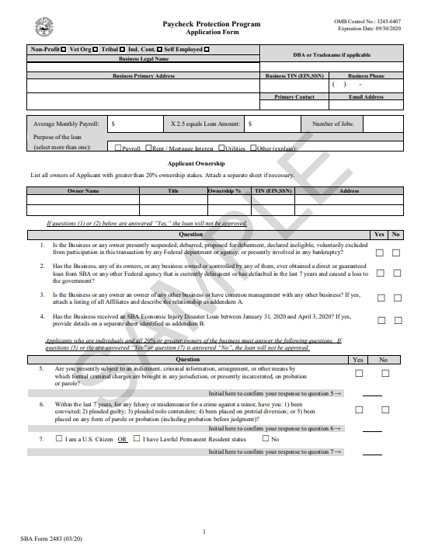
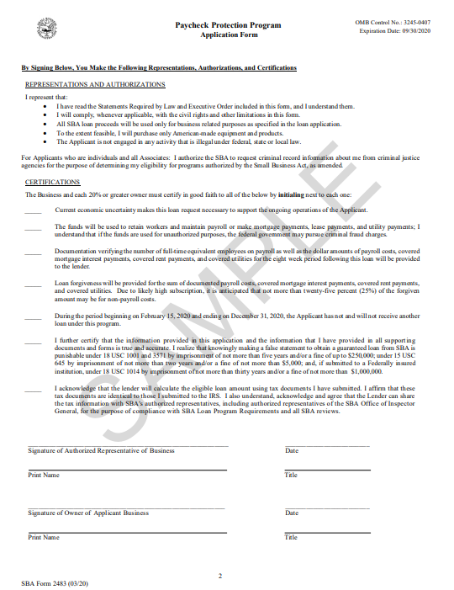

Slide 31
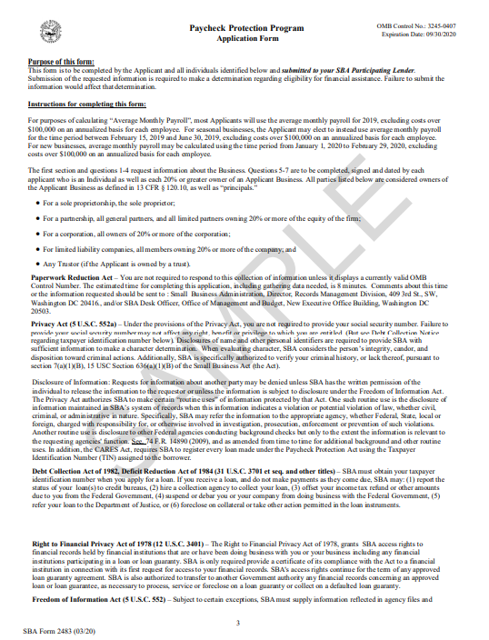
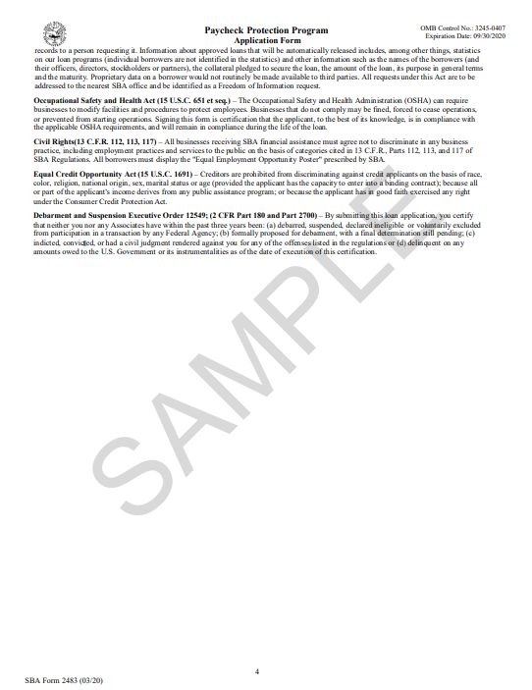

Slide 32
For further information please contact: Mark A. Limardo mlimardo@olshanlaw.com 212.451.2364 Michael J. Passarella mpassarella@olshanlaw.com 212.451.2322

