Slide 1
Marketing in the COVID-19 ERA
Presented by
Olshan’s Brand Management & Protection Practice Group
Third Avenue Business Improvement District
December 16, 2020
For informational and educational purposes only. Not considered legal advice.

Slide 2
Introduction
COVID Claims/ Regulatory Pathway
E-Commerce
Social Media
Privacy Developments/Coops

Slide 3
Hypothetical
Our client, a traditional fashion retailer, has been all but shut down because of the pandemic. It wants to abandon its brick and mortar leases, pivot to an online e-commerce platform and market mostly through social media. It plans to launch a line of hand sanitizers, UV wands and masks intended to ward off the virus.
To drive traffic to its new product line, the company is hiring social influencers to promote its new products. Some of these influencers have touted the life-saving attributes of the masks, claiming to have worn them to super spreader events and returned unscathed.
Because of the costs of acquiring customers, it plans to enroll purchasers into a subscription club in which subscribers receive monthly surprise boxes related to the COVID environment. Consumers will be charged every month for the surprise box. Enrollment went so well that the company is now having trouble meeting the demand for its products and has missed some shipping dates.
Due to the company’s increased e-commerce presence, it has decided to update its online privacy policy from 2013 by copying a competitor’s policy and posting that one. The company also intends to ask customers whether they have had COVID or know someone who has had COVID so that it can market specific products to those people. In addition, the company will participate in a cooperative database in which multiple companies contribute their customer contacts for direct marketing purposes.

Slide 4
COVID-RELATED PRODUCTS AND CLAIMS
Presented by Andrew B. Lustigman

Slide 5
General Regulatory Standards
Claims need to be truthful, not misleading, and substantiated
Marketing techniques that could cause consumer injury are similarly unlawful
Generally judged from a reasonable consumer perspective, unless particular group (i.e., seniors) is a target audience
Cannot claim products prevent any specific disease without having gone through FDA approval process
Heightened scrutiny of COVID-related claims

Slide 7
FDA/FTC COVID-19 Warning Letters
Since the outbreak, the FTC and FDA have issued approximately 300 Warning Letters to businesses making unapproved COVID-related claims
Purpose is to warn companies that their conduct is likely unlawful and that they can face serious legal consequences, such as a federal lawsuit, if they do not immediately stop (i.e., within 48 hrs)
FTC recently obtained a TRO against a marketer that failed to sufficient comply with the spirit of a COVID-related Warning Letter
Not a precondition to FTC/FDA filing lawsuit

Slide 8
FDA/FTC COVID-19 Warning Letters
Typical challenged claims are disease prevention:
Product prevents corona viruses and other viral infections
formulations are preventative for COVID or other viruses
Immune boosting to ward off COVID
Other challenged claims are much broader:
“In light of all the 24/7 news stories about the COVID19 situation, I wanted to share the most effective strategies that I personally recommend and use to support and enhance my immune system

Slide 9
FDA/FTC COVID-19 Warning Letters
Social media posts and hashtags can be considered COVID claims when used to promote a product:
“Ideal for everyday use but especially during this pandemic. Keep your immune system strong! Elderberry syrup has been known to: -boost the immune system…#covid19 #corona”
“Elderberry syrup has been known to: boost the immune system…#corona…#coronakiller”
NsideOut Health July 7, 2020 Warning Letter

Slide 10
Health Claims Trigger Potential Regulatory Pathway Compliance
Hand sanitizers and body wipes
Anti-virus cleaners (sprays and aerosols)
UV lighting systems
Masks

Slide 11
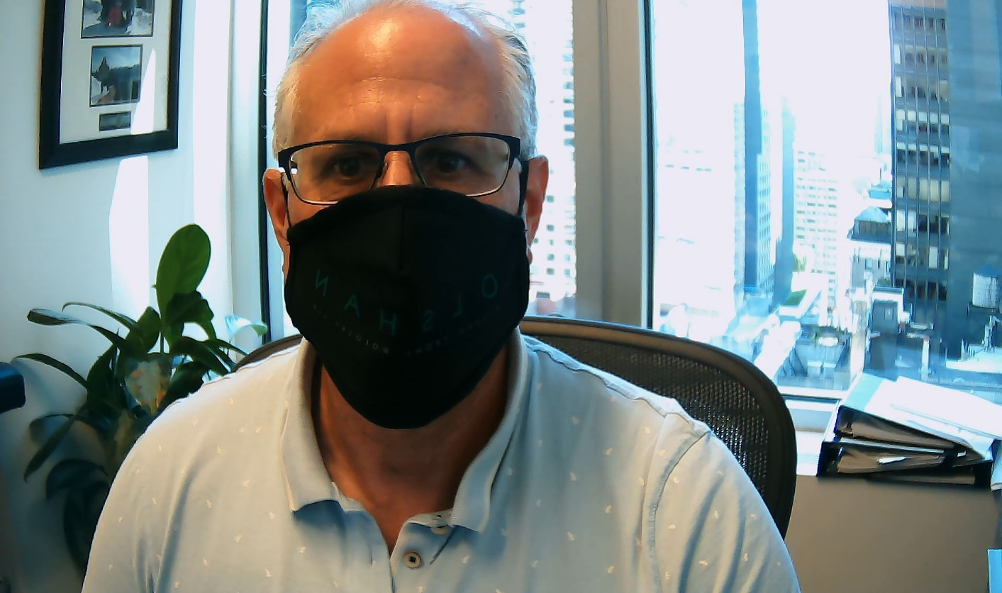
Masks Regulatory Pathway
Assuming no medical claims, not considered a medical device

Slide 12
Industry Enforcement

Slide 13
General purpose disinfectants
Triggers EPA pesticide requirements
Pest broadly defined to include viruses
Descriptors sanitizer, disinfectant, and sterilizer all have specific meanings requiring different levels of clinical support of anti-microbial efficacy
Adverse event reporting and record keeping
EPA Registration and review
Product and establishment requirement
Safety and efficacy review
Conforming labeling and packaging requirements

Slide 14
Hand Sanitizers and Body Wipes
FDA registration required
Treated as an OTC drug regulated by FDA
Antiseptic rub products covered under non-final monograph
Obtain National Drug Code (NDC) Labeler Code
Drug Facts labeling requirements
cGMPs
Registration requirements
Adverse Events Reporting

Slide 15
E-COMMERCE CONSIDERATIONS
Presented by Scott Shaffer

Slide 16
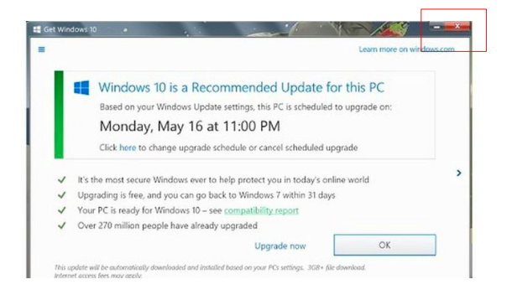
Dark Patterns

Slide 17
Dark Patterns
“Dark patterns” are website features designed to deceive, steer or manipulate consumers towards certain purchase-related decisions they would not otherwise make.
Examples:
Pre-checked boxes that add more items to the check-out basket
Brightly colored radio buttons that direct consumers towards more expensive options
Hiding cancellation or deletion options
Artificial scarcity or time constraints added to drive purchases
Waiting until the last page of the check-out process to disclose certain costs

Slide 18
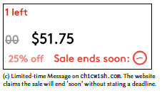
Dark Patterns

Slide 19
Free Trial Offers
ABCmouse used a “roach motel” dark pattern that offered 30-day free trial with the ability to extend memberships beyond the trial period for 6 or 12 months. But the company hid disclosures that membership would be extended automatically and indefinitely after the initial membership ended
Restore Online Shoppers' Confidence Act (“ROSCA”): prohibits post-transaction (negative option) charges unless there is full disclosure of all material terms; express consent to the charges; and simple mechanism to cancel recurring charges
FTC reached a settlement with ABCmouse for $10 million and obtained a change in company's negative option marketing

Slide 21
Automatic Renewal Issues
Besides ROSCA, many states have automatic renewal laws. Common theme among them is that material terms must be clearly and conspicuously disclosed
New York Times lawsuit: class action alleges automatic renewal not disclosed until after payment information given; also that it was exceedingly difficult to cancel online subscriptions
California law requires affirmative consent-- prior to purchase-- of all automatic renewal terms. Terms must be fully disclosed and there must be a simple online cancellation method

Slide 23
Breaking news: new auto-renewal law in New York
Last month, New York joined other states with a burdensome automatic renewal law. It takes effect on February 9th.
It applies to any automatically renewing subscription or purchasing agreement with a consumer (not commercial contracts).
Automatic renewal terms must be in a more clear and conspicuous type than the surrounding text (i.e. larger font or contrasting type or color).
Affirmative consumer consent required, with renewal terms appearing in visual proximity. This invites fact-specific litigation disputes
Consumers must receive an acknowledgment of the renewal that contains cancellation procedures.

Slide 24
E-Commerce Governed by FTC Mail, Internet or Telephone Order Merchandise Rule
Sellers cannot solicit an order without a reasonable basis to expect it will ship the merchandise within the advertised time, or if no delivery time is advertised, then within 30 days
If a seller is unable to meet the shipping requirements, it must offer the buyer an opportunity to either receive a refund or consent to further delay
A seller is also required to honor a refund demand if made prior to shipment.
If the seller fails to offer the opportunity to cancel in event of delayed shipping, the buyer is still entitled to cancel and a prompt refund

Slide 25
Zaappaaz Lawsuit
An example of FTC enforcement is an August lawsuit filed against the company that owns wrist-band.com for failure to honor promises of immediate shipment and refusing refund requests

Slide 26
Takeaways
Avoid the temptation to cross the line by using dark patterns which mislead, deceive or otherwise harm consumers
Do not try to improperly limit a consumer’s right to cancel
Follow the FTC’s Mail Order Rule
Mistakes are inevitable, so adopt website terms of use to protect the company when things go wrong. Examples: class-action waiver and arbitration clause that give the seller control of the dispute resolution process

Slide 27
SOCIAL MEDIA
Presented by: Tamara F. Carmichael

Slide 28
Lawful and Supported Representations
Advertisers must have a reasonable basis to substantiate all claims in their advertisements and marketing materials prior to making the claims
Claims must be consistent with regulatory pathway
This includes all claims made by the company as well as endorsers and influencers
Advertisers may be liable even if they did not authorize, approve, or use the sponsored endorsement or testimonial made on social media

Slide 29
How Do you Disclose a Material Connection Between the Advertiser and the Influencer?
FTC has stated that any material connections between brands and influencers must be disclosed:
Hired as influencers
Employees
Paid
Provided discounts
Provided free products
Received an incentive (e.g. entry into a sweepstakes)
Friend/Family Relationship

Slide 30
FTC Enforcement Policy and Guidelines
Disclosure must be clear and prominent
Sufficient disclosures “#ad,” “#advertising,” “#sponsored,” “Thanks [Brand] for the free [Product],” and “#[Brand]Ambassador”
Insufficient disclosures include “#ambassador,” “#spon,” “Thanks [Brand],” “#sp,” and “#collab”
Ensure the disclosure appears in the first three lines of social media post
Don’t “hide” the disclosure among many other hashtags

Slide 31
Key Points About Endorsements
Must reflect honest opinions/experience of endorser
Bona fide user
Cannot be an express/implied representation that would be deceptive if made by advertiser
Material connection must be either obvious or disclosed
Claims made by endorsers must be substantiated and consistent with claims made by the advertiser

Slide 32
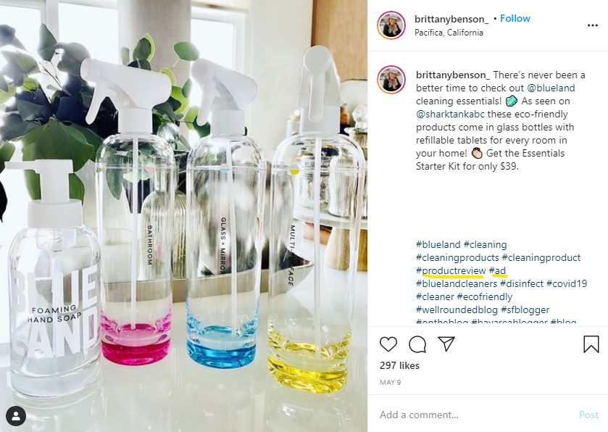

Slide 33
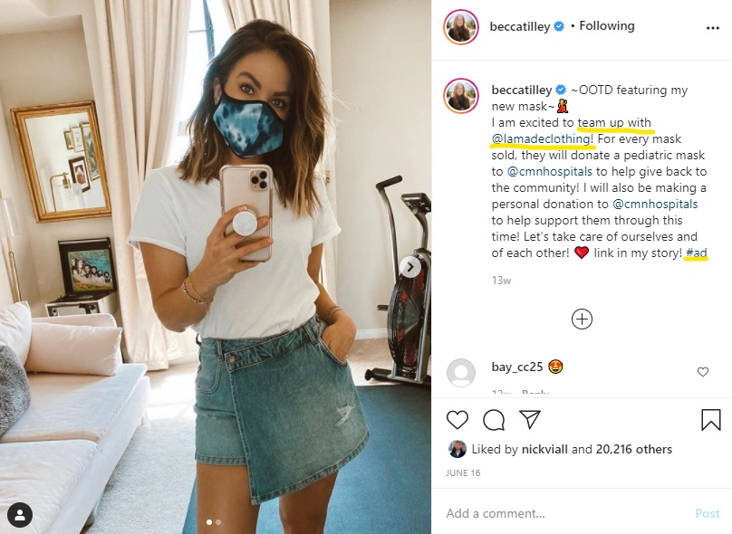

Slide 34
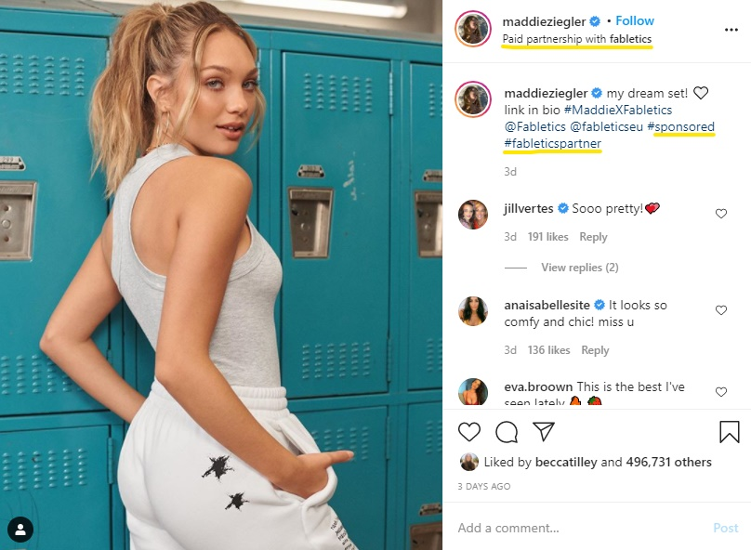

Slide 36
Social Media Takeaways
Embrace disclosure
When in doubt, disclose, and do so prominently.
Be authentic, honest, and not misleading
Don’t have influencers do what the brand itself cannot do
Create a company social media policy, including written agreements with influencers
Establish influencer guidelines
Monitor compliance and address noncompliance
Be smart and mindful. If in doubt, don’t post it

Slide 37
PRIVACY CONSIDERATIONS
Presented by Mary L. Grieco

Slide 38
Data Collection and Use
Businesses must be aware of their data collection and use practices
Privacy laws in the U.S. are a mish-mash of other laws
How does a company know what to follow?

Slide 39
Best Practices
What types of data are collected?
Personal data provided by customers and personal data collected automatically
What is done with the data?
Use for business purposes only
Exchange or sale of data
Creation of consumer profiles
Marketing
What disclosures are given to consumers at the time of collection?
What laws apply?

Slide 40
Relevant Laws
California Consumer Privacy Act (CCPA)
First all-encompassing privacy law in the United States
Requires certain disclosures at the time of collection
Provides consumers with rights of access, deletion, and opt-out of the “sale” of personal information
Children’s Online Privacy Protection Act (COPPA)
Federal law prohibiting collection and use of personal data from children under 13 without parental consent
Gramm-Leach Bliley Act
Federal law governing the collection and use of financial information
Health Insurance Portability and Accountability Act (HIPAA)
Federal law governing collection and use of medical information

Slide 41
Hypothetical Issues
Privacy polices cannot be “cookie cutter”
Everything in the policy must be accurate
If a company changes its practices, it must notify everyone in its database of the changes to allow opt-ins
Contributing to a cooperative database is a “sale” of information under California law, which triggers additional requirements for businesses
Collecting heightened personal data, such as health conditions, can trigger heightened responsibilities
Creating consumer profiles for targeted advertising can also trigger heightened responsibilities
Promotions that collect personal data must comply with relevant laws
Many privacy laws (such as CCPA) apply to data collected off-line as well

Slide 42
Questions?

Slide 43
Olshan
Branding
Management &
Protection
Practice Group
Andrew B. Lustigman
(212) 451-2258
alustigman@olshanlaw.com
Mary L. Grieco
(212) 451-2389
mgrieco@olshanlaw.com
Tamara F. Carmichael
(212) 451-2291
tcarmichael@olshanlaw.com
Morgan E. Spina
(212) 451-2343
mspina@olshanlaw.com
Scott Shaffer
(212) 451-2302
sshaffer@olshanlaw.com
Olshan Frome Wolosky LLP
1325 Avenue of the Americas
New York, NY 10019
(212) 451-2300

